Slide 1
Health and Lifestyle Data Analysis
DATA SCIENCE

Slide 2
Group Members
01
MISHA NADEEM
37294
02
MUHAMMAD FAHEEM
42346

Slide 3
Introduction
Part 01

Slide 4

Introduction
This project analyzes how daily lifestyle habits affect human health.
The dataset contains information about sleep, exercise, diet, stress, smoking, and health status.
The goal is to use data science techniques to understand and predict health conditions.

Slide 5
Dataset Description
Part 02

Slide 6


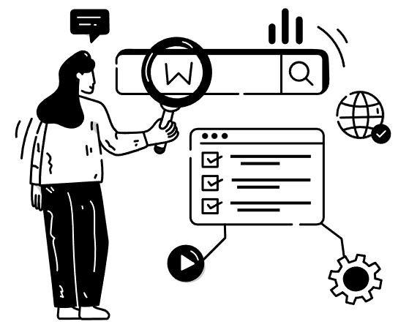
Dataset Description
Age
Gender
Sleep Hours
Exercise Hours
Diet Type
Stress Level
Smoking
Alcohol Consumption
BMI
Health Status

Slide 7
Problem Statement
Part 03

Slide 8

Problem Statement
Unhealthy lifestyle habits are increasing health problems worldwide.
This project aims to analyze lifestyle data to identify the key factors that affect human health.

Slide 9
Objectives
Part 04

Slide 10

Objectives
To analyze health and lifestyle data
To find relationships between habits and health
To predict health condition using machine learning
To help people improve their lifestyle

Slide 11
Data Preprocessing
Part 05

Slide 12

Data Preprocessing
The data was cleaned and prepared by:
Removing missing values
Encoding categorical variables
Normalizing numeric values
Removing outliers

Slide 13
Exploratory Data Analysis
Part 06

Slide 14

Exploratory Data Analysis
We analyzed:
Sleep vs Health
Exercise vs BMI
Stress vs Health
Smoking vs Disease

Slide 15
Machine Learning Model
Part 07

Slide 16
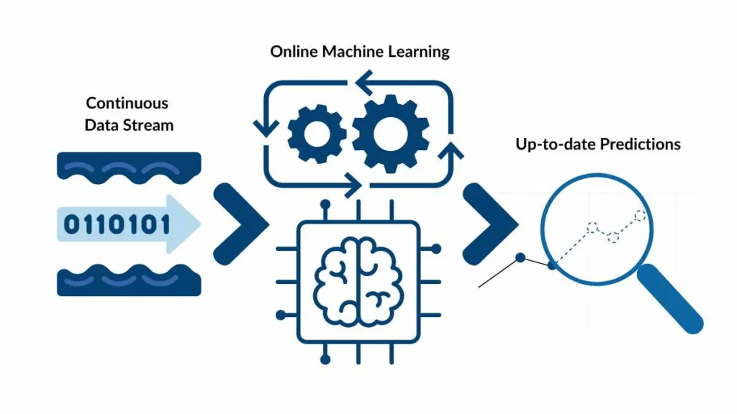
Machine Learning Model
We used models such as:
Logistic Regression
K-Nearest Neighbors
Decision Tree
These models predict whether a person is Healthy or Unhealthy.

Slide 17
Results
Part 08

Slide 18

Results
The model showed:
Higher sleep and exercise lead to better health
Smoking and high stress lead to poor health
Good accuracy in health prediction

Slide 19
Conclusion
Part 09

Slide 20

Conclusion
Healthy lifestyle habits greatly improve health.
Data science can help predict diseases and improve quality of life.

Slide 21
THANKS

